Slide 1

E-mails and Memorandums

Slide 2


E-mail for Business

Slide 3
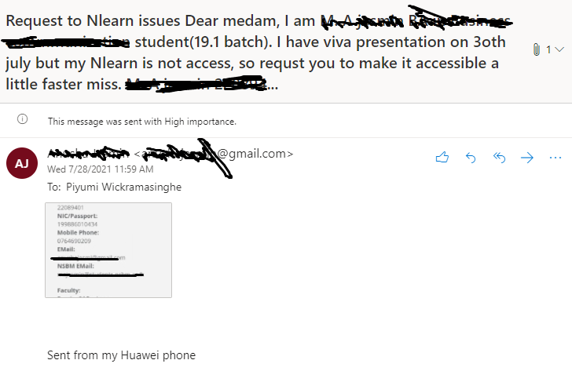







Slide 4
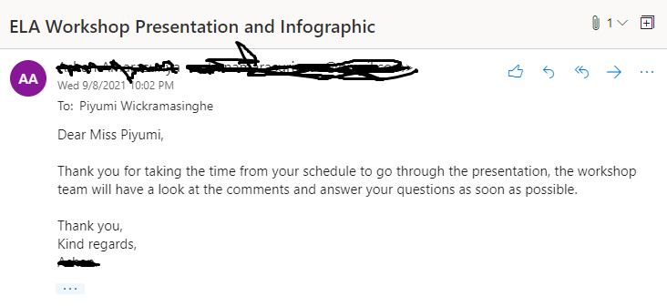




Slide 5
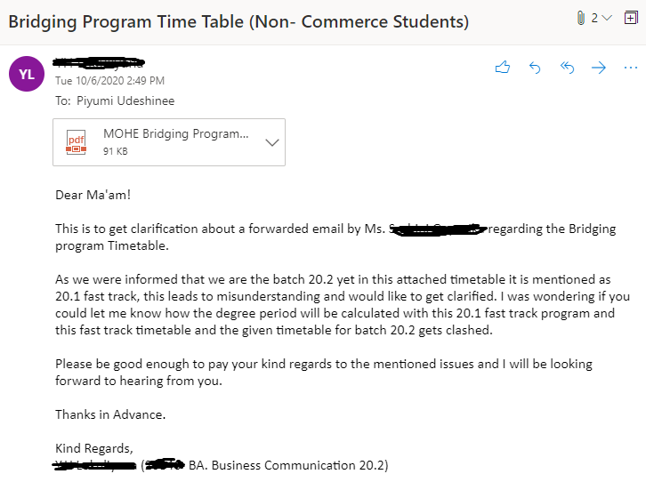





Slide 6
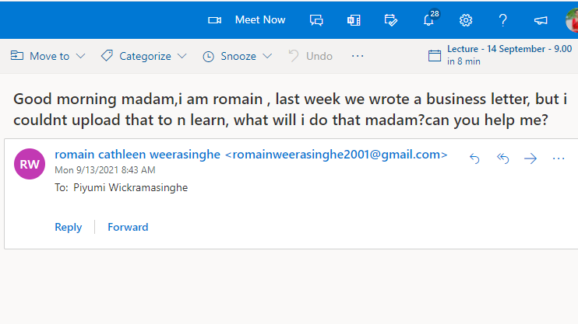



Slide 7



Slide 8




Slide 9
Top 10 complaints about email practice
Vague subject line
No greeting
No sign off
Poor formatting
Vague messages
Tell me what to do
Unfriendly tone
CC to the whole world
Bad grammar, bad spelling and bad punctuation
Rushed messages

Slide 10
E-mailing Etiquette / Netiquette
Only discuss public matters
Briefly introduce yourself
Don't "e-mail angry
Use exclamation points sparingly
Be careful with confidential information
Respond in a timely fashion
Refrain from sending one-liners
Avoid using shortcuts to real words, emoticons, jargon, or slang
Keep it clean
Be clear in your subject line

Slide 11
Netiquette Contd.
11. Don't get mistaken for Spam
12. Your subject line must match the message
13. Provide a warning when sending large attachments
14. No more than two attachments, and provide a logical name
15. Send or copy others only on a need to know basis
16. Beware of the "reply all."
17. Pick up the phone
18. Evaluate the importance of your e-mail
19. Maintain privacy
20. Keep it short and get to the point

Slide 12
Netiquette Contd.
Know your audience
Always include a signature
Only use an auto-responder when necessary
Train your staff
Your e-mail is a reflection of you

Slide 13
E-mail Format
From :
Date :
To :
CC :
Subject :
Salutation
……………………………………………………………………………………………………………………………………………………………………………………………………………………………………………………………………………………………………………………………………………………………………………………………..
Thank you
Digital Signature
Designation
Affiliation

Slide 14
Activity
Think of a time you had to write an email to any of your module lecturers about some issue related to the module. Write that email.

Slide 15
Memorandums

Slide 16
What is a Memo?
A memo is a written message from one person to another (or several people) within the same organization.
Memos (Memoranda) serve several purposes:
1. To provide information 2. To request information 3. To inform of actions, decisions 4. To request actions, decisions

Slide 17
Memos are formatted differently from letters:
Omit the complimentary opening (Dear Dr. Bartlet:) and complimentary close (Sincerely, Mary Walker) that are included in a letter.
Omit the mailing and return address (because memos are typically internal—sent between employees of the same company—no addresses are needed).
If sending a hard copy, initial or sign the memo next to your name on the "From" line. Label the memo "Memo "Memorandum," etc. at the top of the page, as in the examples below.

Slide 18
Memorandum
To : Receiver’s Name/s and Designation/s
Through: name , designation
From : Sender’s name and Designation
CC : Name of person/s to whom you send the copy
Date : Day Month Year
Subject : Main purpose of sending the memo
..............Reason for the memo……………………..............................
.........Any Instructions or information……………………………….
………What is required of the reader e.g.Confirmation, answers or
feedback…………………….................................................................
…………………………………………………………………………
Enc

Slide 19
To : All the members of the staff, ABC Company
From : Secretary, ABC Company
CC : Director General, ABC Company
Date : 26 April 2020
Subject : Annual General Meeting
The Annual General Meeting of our company will be held at 10.00 am on Friday, 10 May 2020 at the auditorium.
The Director General will chair the meeting and there will be a discussion about the annual progress of the company.
I am enclosing the agenda of the meeting and please be on time for the meeting with all the relevant documents.
Enc

Slide 20
Q&A

